Slide 1
No Rest till gRpc!
TITLE UBUNTU CAPS (WORK FOR 1 OR 2 LINES OF TITLE)
TITLE UBUNTU CAPS(WORK FOR 1 OR 2 LINES OF TITLE)

Slide 2

No Rest till gRpc!

Slide 3

When it comes to communications, most coders have clear preferences:
But we got alternatives, like signalr, mqs, or...

Slide 4
"A high performance, open-source universal RPC framework
G(?)
R(emote)
P(rocedure)
C(all)

Slide 5
Grpc... - uses binary messages formatted by protocol buffers - must be strictly contract compliant - is platform-independent - is Http2 based - is secure by default (https only!) - can be used for both unary and stream requests, also bi-directional

Slide 6
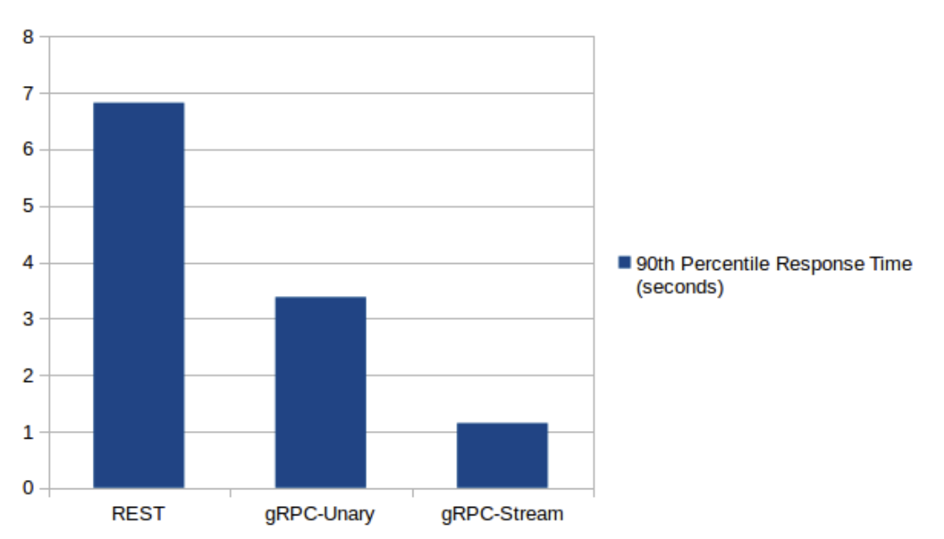
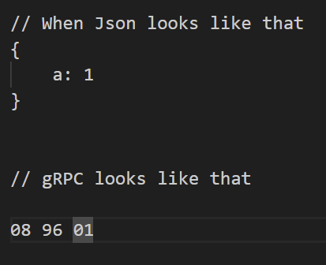
http 2 gprc vs http 1.1 rest api – speed and message forms

Slide 7
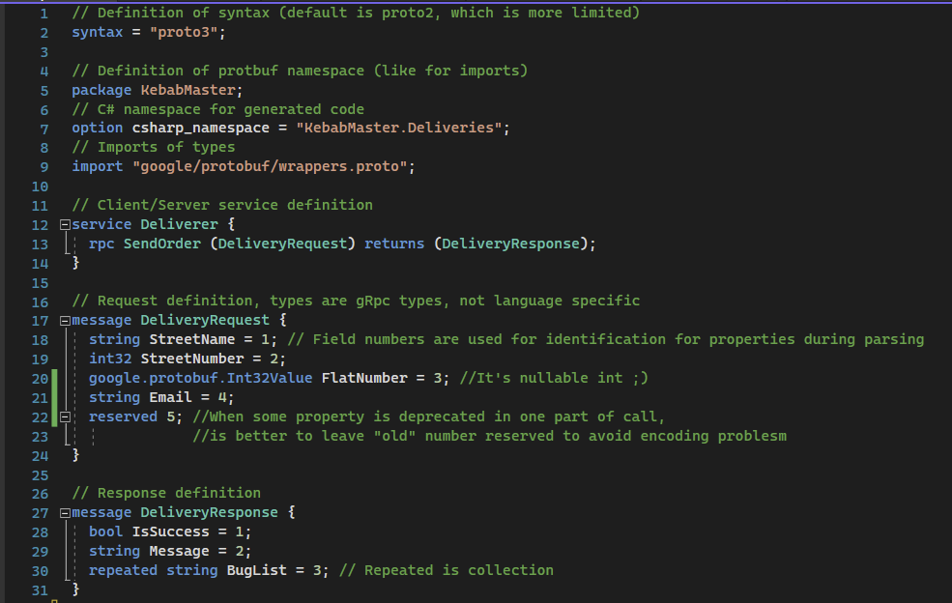
Grpc uses protocol buffers, which is schema language for message encoding and validating contracts

Slide 8
Security
Grpc, uses standard http-based security mechanisms, like certifications and tokens

Slide 9
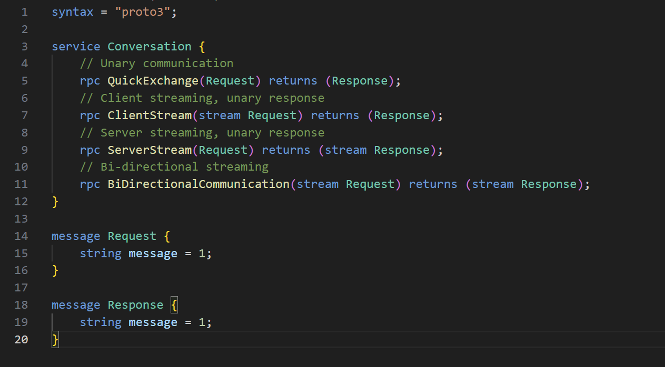
Grpc uses unary and stream-based communication

Slide 10
Disadvantages:
While grpc has many advantages, it’s learning curve is steeper and you need more tools.
Average Rest enjoyer saying how to make a request:
- Paste this in browser and hit enter
Average grpc fan:

Slide 11

GET THE FUTURE YOU WANT
capgemini.com

Slide 12
About Capgemini
Capgemini is a global leader in partnering with companies to transform and manage their business by harnessing the power of technology. The Group is guided everyday by its purpose of unleashing human energy through technology for an inclusive and sustainable future. It is a responsible and diverse organization of over 360,000 team members more than 50 countries. With its strong 55-year heritage and deep industry expertise, Capgemini is trusted by its clients to address the entire breadth of their business needs, from strategy and design to operations, fueled by the fast evolving and innovative world of cloud, data, AI, connectivity, software, digital engineering and platforms. The Group reported in 2022 global revenues of €22 billion.
Get The Future You Want | www.capgemini.com

